Slide 1

Security Support in Android Platform
Hisham Mahfouz
Mazen Amr

Slide 2
Agenda
Android System Structure
Device integrity
Data Protection
Application Security
Network Security
Android Security Updates
Google Security services

Slide 3
Android System Structure
Android OS:
An open source OS that’s built on the Linux kernel
provides an environment for multiple apps to run simultaneously
apps are signed and isolated into application sandboxes
sandbox defines the privileges available to the application
Apps are generally built using Android Runtime
Apps interact with the OS through a framework
The Framework describes system services, APIs and message formats

Slide 4
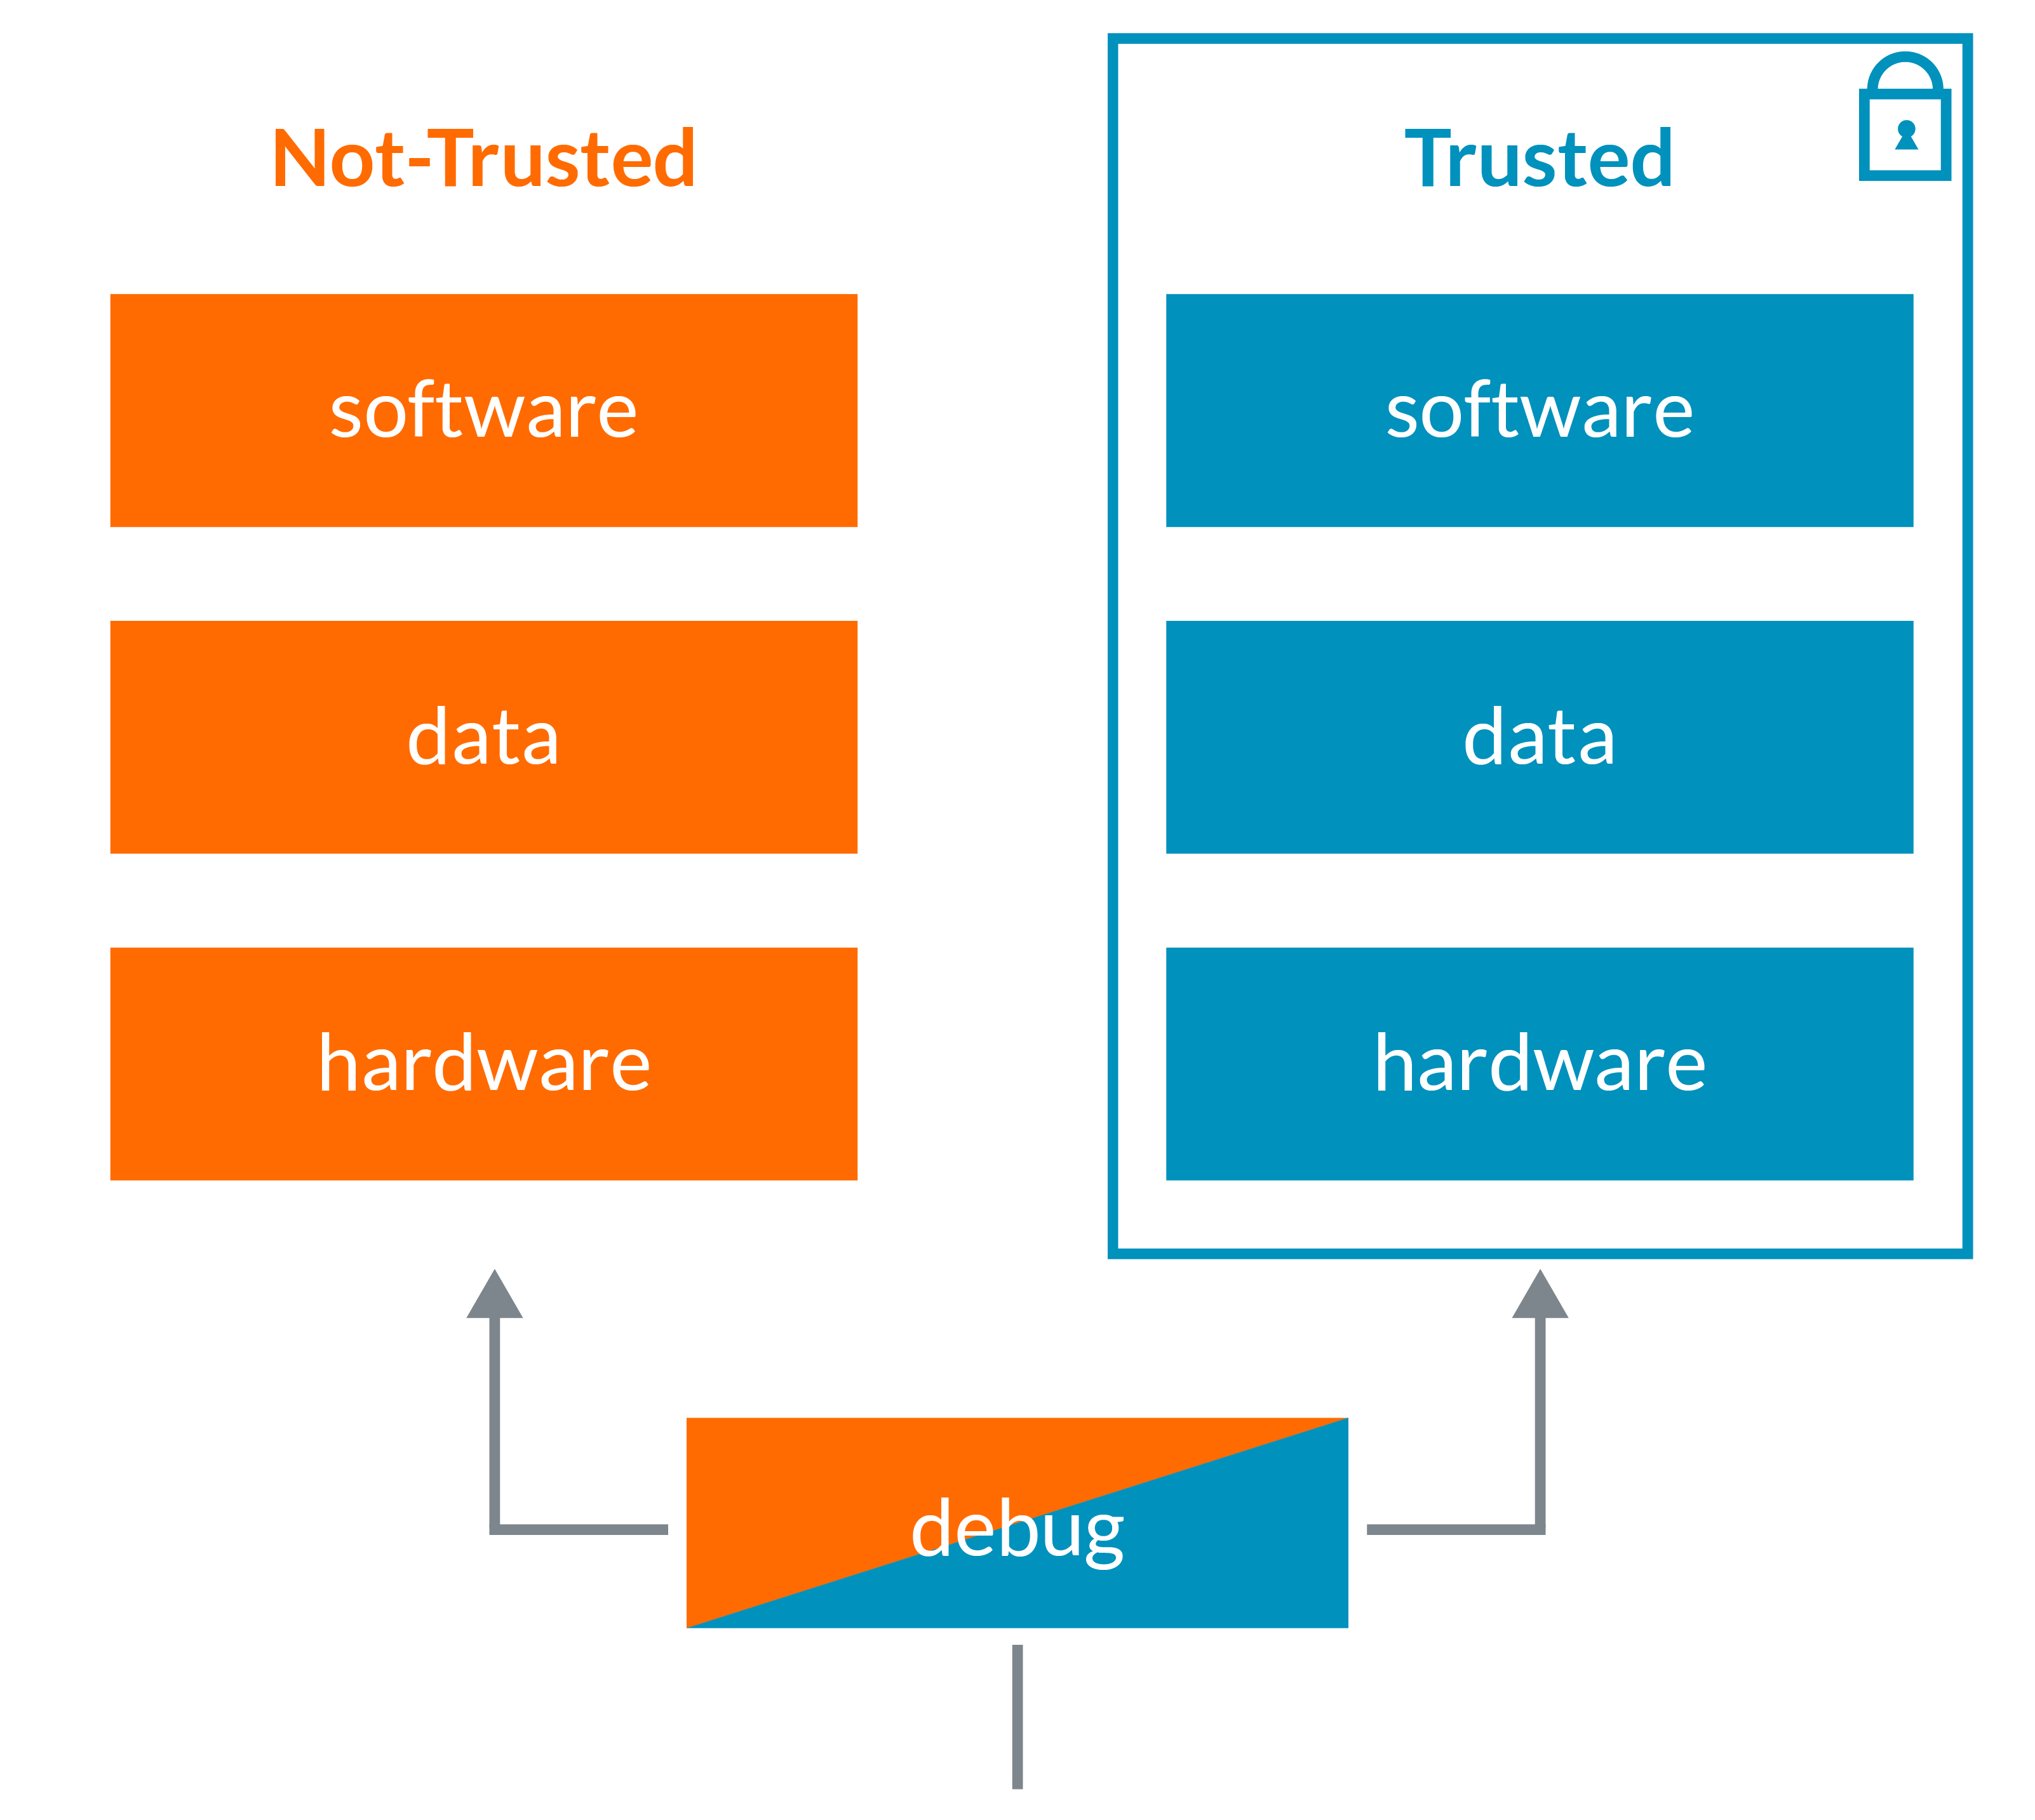
Android System Structure
Trusted Execution Environment(Android 7.0+):
Secondary isolated Environment implemented using secure hardware such as ARM TrustZone technology
TEE is responsible for:
  Lock screen passcode verification
  Fingerprint template matching
  Protection and management of KeyStore Keys

Slide 5
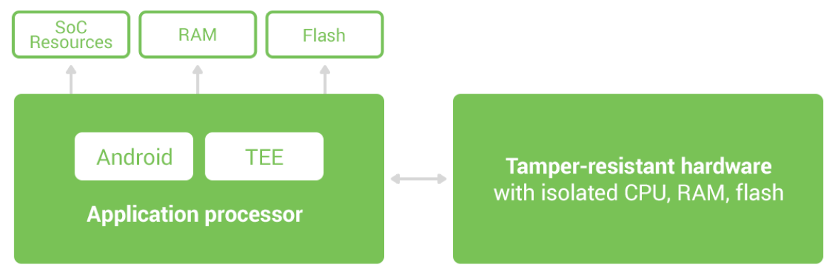
Android System Structure
Tamper-resistant hardware :
built with additional protections against physical tampering
only shares very limited resources with the main application processor , significantly reducing its attack surface and the potential of side channel attacks.
verify the lock screen passcode(Android 8.0)

Slide 6
Security Support in Android Platform
Device Integrity:
Features that protect the mobile device from any changes to the operating system.
Verified Boot
Sandboxing
  SELinux
  Seccomp filter
  FileSystem sandboxing

Slide 7
Device Integrity
Features that protect the mobile device from any changes to the operating system.
Verified Boot:
Verified Boot mitigates attacks against devices by providing a boot process that verifies system software using a hardware root of trust.
Each Verified Boot stage is cryptographically signed
Each phase of the boot process verifies the integrity of the subsequent phase, prior to executing that code
The Verified Boot state is used as an input in the process to derive disk encryption keys. If the Verified Boot state changes (e.g. the user unlocks the bootloader), then the secure hardware prevents access to data used to derive disk encryption keys.

Slide 8
Device Integrity
Sandboxing:
runs all apps inside sandboxes to prevent malicious or buggy app code from compromising other apps or the rest of the system.
App sandboxing is enforced in the kernel and extends to the entire app regardless of development environment, APIs used, or programming language.
system components run in least-privileged sandboxes in order to prevent compromises in one component from affecting others.
Sandboxing techniques:
  SELinux: enforce mandatory access control (MAC) over all processes and apps, even processes running with root and super user privileges. Violations are blocked.
  Seccomp filter: restrict App access to some kernel system calls that pose risks
  Filesystem sandboxing: Each App has it’s own files and resources that others can’t access

Slide 9
Data Protection
Encryption:
Full Disk Encryption: process of encoding all user data on an Android device using a single encryption key. All data is encrypted before commit and decrypted before returning it to process. Users need to provide credentials before using basic phone functionality
File based Encryption(FBE) and Direct Boot: Also Encrypts all data while also providing APIs that support basic functionality within limited context before users have provided their credentials while still protecting private information by allowing devices to boot up to the directly to the lock screen.
  Credential Encrypted Storage: default storage location and only available after the user has unlocked the device
  Device Encrypted Storage: location available during Direct Boot

Slide 10
Data Protection
Lock Screen:
Unlock credentials are verified using Tamper resistant hardware(Android 8.0)
Finger Print :
  A false acceptance rate not higher than 0.002% and a false rejection rate of less than 10%
  After 5 rejected attempts, leave at least 30 seconds between subsequent attempts
  Prevent addition of a fingerprint without first establishing a chain of trust by having the user confirm an existing device credential or add a new device credential (PIN/pattern/password).
Trust Agent framework: Google Smart Lock uses that framework to allow a device to remain unlocked as long as it stays with the user, as determined by certain user presence or other signals.

Slide 11
Application Security
Application Signing:
All apps are digitally signed with a developer key prior to installation used when:
  Identifying Application Author
  System install an App update
  Allow Apps with same signature to be in the same process(Sand Box) if requested
  Signature based permissions
Android provides signature-based permissions enforcement, so that an application can expose functionality to another app that’s signed with the same key.

Slide 12
Application Security
Application Permissions:
Apps, by default, have very limited capabilities and must get additional permissions from the user.
Apps that target API level 23 or higher use runtime permissions, where they prompt users to accept permissions at runtime rather than at installation.
Privacy-sensitive device identifiers are either no longer accessible or gated behind a runtime permission(Android 8.0).
The user can revoke the permissions at any time

Slide 13
Application Security
Hardware-backed KeyStore and KeyChain:
KeyStore:
  lets you manage private keys in secure hardware to make them more difficult to extract from the device(authentication credentials, encryption or signing purposes)
  binds keys to an operating system and patch level version.
KeyStore key attestation:
    empowers a server to gain assurance about the properties of keys, verify that they are signed properly and confirm they’re protected.
KeyChain:
allow apps to use the system credential storage for private keys and certificate chains. KeyChain is often used by Chrome, Virtual Private Network (VPN) apps, and many enterprise apps to access keys imported by the user or by the mobile device management app.

Slide 14
Network security
Wi-Fi:
Android supports the WPA2-Enterprise (802.11i) protocol
VPN:
Always-on-VPN:
  Apps don’t have access to the network until a VPN connection is established.
Per User VPN:
  On multi-user devices, VPNs are applied per (Android user or work profile), so all network traffic is routed through a VPN without affecting other users on the device
Per Application VPN:
  Allow VPN connections on allowed apps and to prevent VPN connections on disallowed apps.

Slide 15
Network security
Certificate Handling(Android 7.0):
Certificate authorities (CA) are a vital component of the public key infrastructure used in establishing secure communication sessions via Transport Layer Security (TLS).
devices trust only the standardized system CAs maintained in AOSP.
Apps can also choose to trust user- or admin- added Cas
Trust can be specified across the whole app or only for connections to certain domains.
Apps can include the private CAs in the components/apps themselves if needed to enable accessing carrier infrastructure.

Slide 16
Android Monthly Updates
Monthly device updates are an important tool to keep Android users safe.
Every month, Google publishes Android Security Bulletins to update users, partners, and customers on the latest fixes.
These security updates are available for three years from release.
Additionally, security-critical fixes are pushed to most Android OEM monthly
A root certificate that is signed with the Google attestation root key that contains security patch level of a build is available on each device

Slide 17
Google security services
Google Play Protect(Android 4.2):
threat detection service that actively monitors a device to protect it, its data, and its apps from malware
can remove malicious apps automatically as part of its prevention initiative
SafetyNet:
A set of Google Play Protect APIs that protects apps against security threats.
Google Play app review:
Review Developer upon creating his account using profile and credit card data
Review said developer App before making it available on the Store.

Slide 18
References
https://source.android.com/security
https://source.android.com/security/reports/Google_Android_Enterprise_Security_Whitepaper_2018.pdf
https://www.microcontrollertips.com/embedded-security-brief-arm-trustzone-explained/

